Slide 1
presentation begins
A WEBSITE

Slide 2
Contents
About us
1
Creative info
2
Data analysis
3
This is the subtitle that makes it comprehensible
This is the subtitle that makes it comprehensible
This is the subtitle that makes it comprehensible

Slide 3
IDEA
We are working on a metasearch website that compares prices and offers provided by many different online venue booking sites and show vast variety of venues at one place.

Slide 4
NEED
People have to spend a lot of money and time just to find out an ideal venue for any function.
Convenience for the customers as they don’t have to go visit multiple websites and compare prices and offers by their own.

Slide 5
NEED
More and More venues are coming online so we need a platform to manage them.

Slide 6
STATISTICS
Online venue booking marketplace has shown more than 40% upswing in demand as compared to February 2020 since Unlock 3.0 .
They received 30,000+ inquiries from customers for events in just One Month (July 2020) .
They have contributed more than 80% of it’s venue partner’s business during the lockdown period between May 2020 and July 2020 .

Slide 7
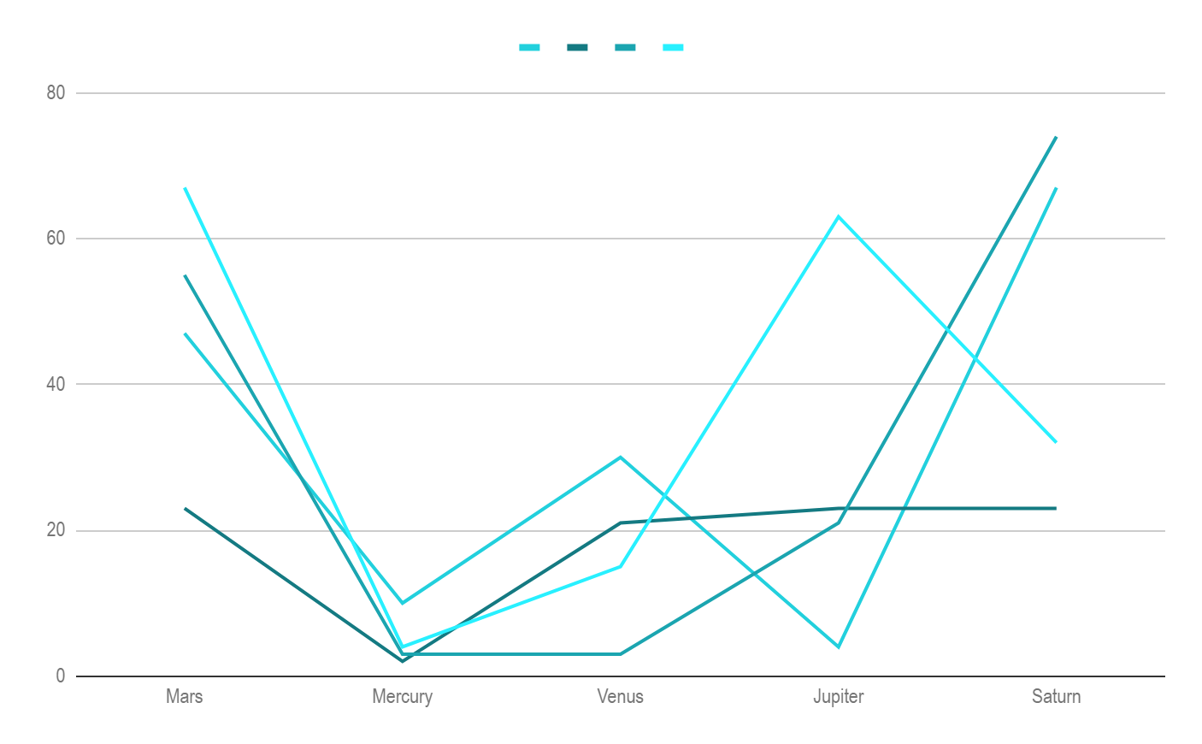
If you want to modify this graph, click on it, follow the link,
change the data and replace it
MERCURY Mercury is the closest planet to the Sun and is only a bit larger than our Moon
JUPITER It’s a gas giant and the biggest planet in our Solar System
MARS Despite being red, Mars is a cold place, not hot. The planet is full of iron oxide dust
VENUS Venus has a beautiful name, but it’s terribly hot, even hotter than Mercury
7

Slide 8
EXPLANATION
We are working on a website which would compare different prices(if any) of the same venues on different websites.
It would also provide a platform for small website to compete with big venue booking websites equally.

Slide 9
BENEFITS
CUSTOMER'S BENEFITS
PARTNERED WEBSITE'S BENEFITS
Their is no need for the customers to visit different website and calculate the price on different websites by themselves.
If same venue is listed on different website with different prices they would get the best price.
They would get a vast variety of venues at one place.
The main aim of this website is to provide equal opportunity to all the websites whether they have fund to invest for advertisements or not.
Their marketing and advertising cost would be saved.
They would be paying only for the customer who is coming on their website.

Slide 10
BUSINESS
How we would make money ?
Whenever a customer is linked to our partnered website we would get a small amount of money.
Why would they give us money ?
Because we are saving their marketing cost, we would advertise our website which would eventually give customer or traffic to their website.

Slide 11
IMPLEMENTATION
We have already started working on the website.
We have taken Data from two website i.e. weddingz.in and bookeventz.com.
Currently around 1,800 venues are listed on my website and looking forward to increase numbers to more than 5,000.

Slide 12
Thank You!
Does anyone have any questions?

Slide 13
CREDITS
Shradha Gupta
Saamer Saiyed Hasnain
Pooja Balyan
Shubham Mittal

